Slide 1


Slide 2



Advanced Programming Applications
Lecture 04- JavaFX – Part I
Dr. Mohamed Mostafa Eltaweel

Slide 3
Lecture Outline
What are JavaFX?
JavaFX vs Legacy Swing
JavaFX Architecture
JavaFX Basic Application Structure
Preparing a Scene
Important packages of JavaFX
Panes, UI Controls, and Shapes
Practice

Slide 4

What are JavaFX?
JavaFX is a Java library (complete API) used to build Rich Internet Applications to build GUI applications with rich graphics..
The applications written using this library can run consistently across multiple platforms.
The applications developed using JavaFX can run on various devices such as Desktop Computers, Mobile Phones, TVs, Tablets, etc.
It replaced the use of Advanced Windowing Tool Kit and Swing Libraries.

Slide 5
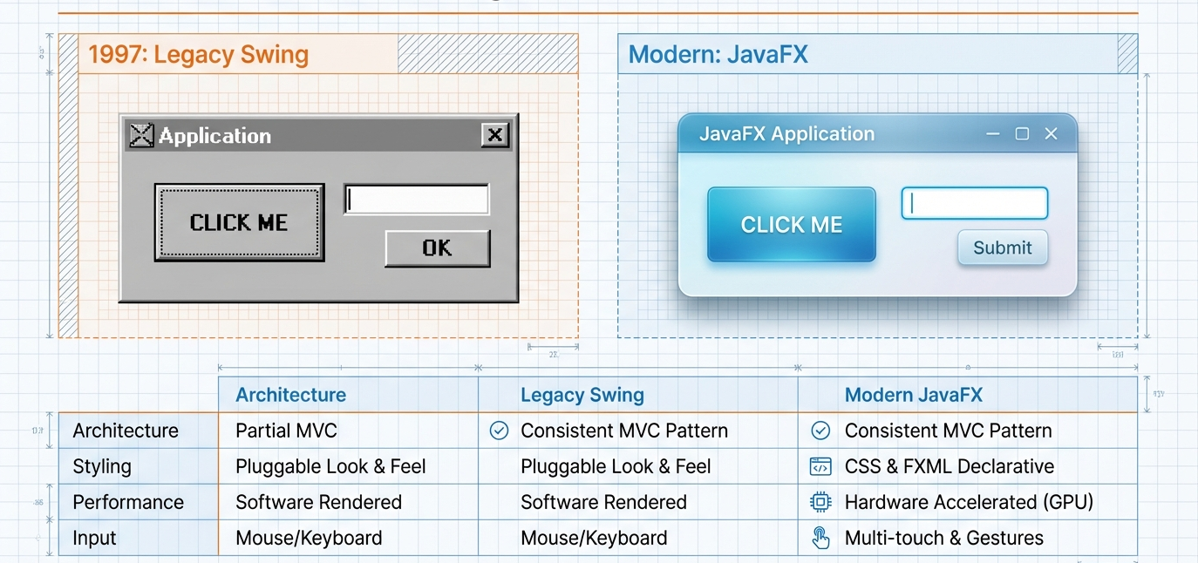
JavaFX vs Legacy Swing

Slide 6

JavaFX Architecture
JavaFX follows a Scene Graph architecture.
Core Components:
Stage
Scene
Nodes
Stage (Window)
→ Scene
→ Layout Pane
→ Controls (Button, Label, etc.)

Slide 7
JavaFX Basic Application Structure
import javafx.application.Application;
import javafx.stage.Stage;
public class Main extends Application {
@Override
public void start(Stage primaryStage) {
primaryStage.setTitle("My First JavaFX App");
primaryStage.show();
}
public static void main(String[] args) {
launch(args);
}
}
base class
window
entry point
starts JavaFX runtime
Notes:
Application → base class
start() → entry point
Stage → window
launch() → starts JavaFX runtime

Slide 8
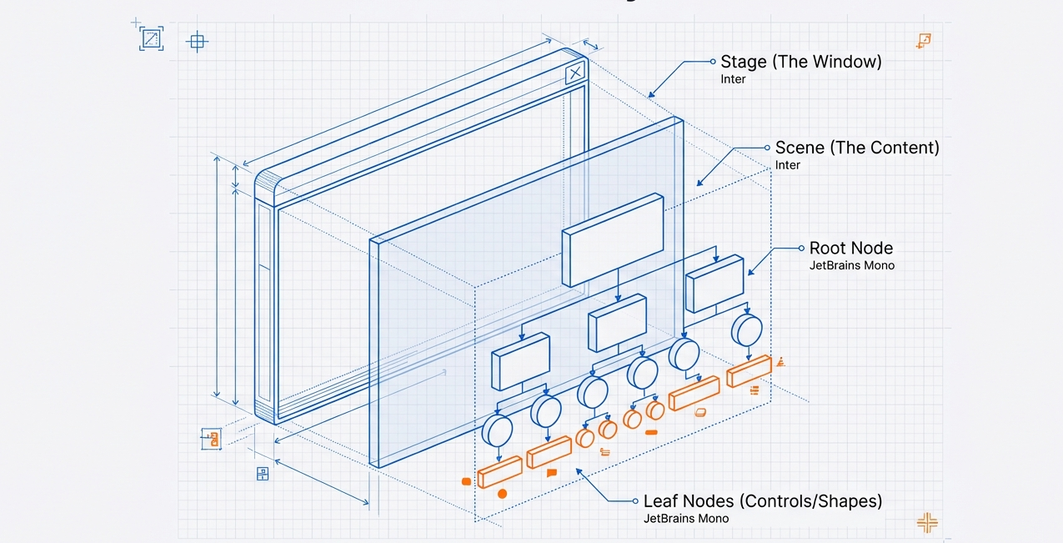
JavaFX Hierarchy

Slide 9
Stage, Scene, and Nodes
1. Stage
Represents the window. A stage has two parameters determining its position namely Width and Height.
You have to call the show() method to display the contents of a stage.
primaryStage.setWidth(400);
primaryStage.setHeight(300);
2. Scene
A tree-like data structure (hierarchical) representing Container for all content.
Scene scene = new Scene(root, 400, 300);
primaryStage.setScene(scene);
3. Nodes
A visual/graphical object of a scene graph. Everything in JavaFX is a Node:
Button, Label, TextField, Layout panes, Shapes
Notes:
The primary stage is created by the platform itself. The created stage object is passed as an argument to the start() method of the Application class

Slide 10
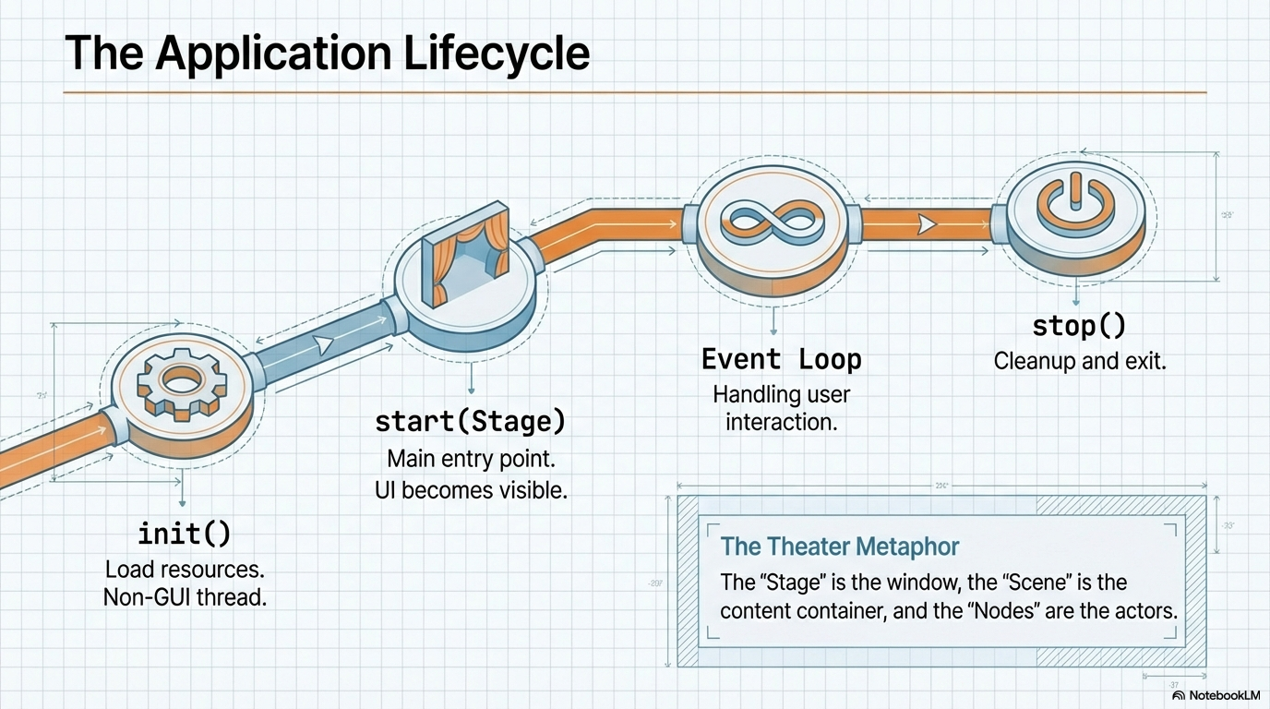
JavaFX Basic Application Structure
Notes:
he JavaFX Application class has three life cycle methods, which are −
start() − The entry point method where the JavaFX graphics code is to be written.
stop() − An empty method which can be overridden, here you can write the logic to stop the application.
init() − An empty method which can be overridden, but you cannot create stage or scene in this method.
To create a JavaFX application, you need to instantiate the Application class and implement its abstract method start(). In this method, we will write the code for the JavaFX Application.
Application Class
The Application class of the package javafx.application is the entry point of the application in JavaFX. To create a JavaFX application, you need to inherit this class and implement its abstract method start(). In this method, you need to write the entire code for the JavaFX graphics
In the main method, you have to launch the application using the launch() method. This method internally calls the start() method of the Application class as shown in the following program.
Application → base class
start() → entry point
Stage → window
launch() → starts JavaFX runtime

Slide 11
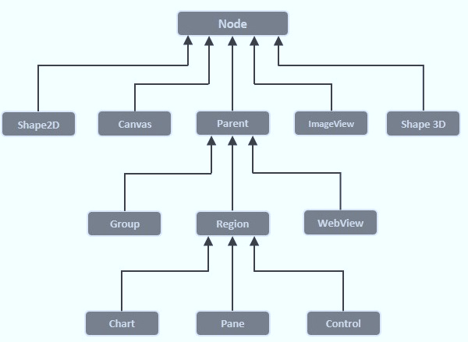
Preparing a Scene
To build a JavaFX application, you must create a scene graph with the required nodes. The first node is the root node, which serves as the top-level container. The root can be a Group, Region, or WebView.

Slide 12
Preparing a Scene
Group − A Group node is represented by the class named Group which belongs to the package javafx.scene, you can create a Group node by instantiating this class
Group root = new Group();
@Override public void start(Stage stage) { TextField t1 = new TextField(); t1.setLayoutX(100); t1.setLayoutY(50); TextField t2 = new TextField(); t2.setLayoutX(100); t2.setLayoutY(90); Button btn = new Button("Submit"); btn.setLayoutX(120); btn.setLayoutY(130);
Group root = new Group(t1, t2, btn); Scene scene = new Scene(root, 400, 250); stage.setScene(scene); stage.setTitle("Form"); stage.show(); } public static void main(String[] args) { launch(); } }
Notes:
The getChildren() method of the Group class gives you an object of the ObservableList class which holds the nodes.

Slide 13
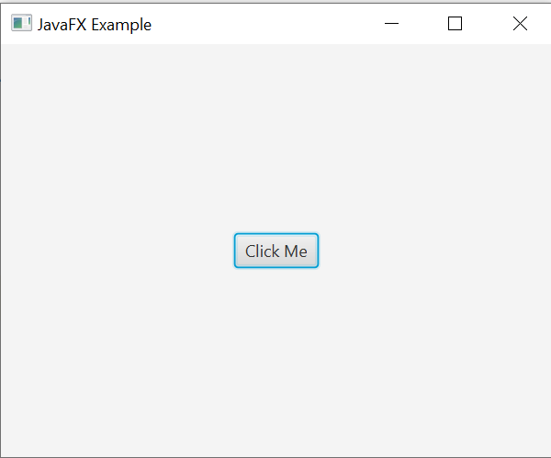
import javafx.application.Application; import javafx.scene.Scene;
import javafx.scene.control.Button; import javafx.scene.layout.StackPane;
import javafx.stage.Stage; import javafx.scene.paint.Color;
public class HelloFX extends Application {
@Override
public void start(Stage stage) {
Button btn = new Button("Click Me");
StackPane root = new StackPane();
root.getChildren().add(btn);
Scene scene = new Scene(root, 400, 300);
//setting color to the scene
scene.setFill(Color.BROWN);
stage.setTitle("JavaFX Example");
stage.setScene(scene);
stage.show();
}
public static void main(String[] args) {
launch();
}
}

Slide 14
Important packages of JavaFX
javafx.application − Contains a set of classes responsible for the JavaFX application life cycle.
javafx.animation − Contains classes to add transition based animations such as fill, fade, rotate, scale and translation, to the JavaFX nodes.
javafx.css − Contains classes to add CSSlike styling to JavaFX GUI applications.
javafx.event − Contains classes and interfaces to deliver and handle JavaFX events.
javafx.geometry − Contains classes to define 2D objects and perform operations on them.
javafx.stage − This package holds the top level container classes for JavaFX application.
javafx.scene − This package provides classes and interfaces to support the scene graph. In addition, it also provides sub-packages such as canvas, chart, control, effect, image, input, layout, media, paint, shape, text, transform, web, etc. There are several components that support this rich API of JavaFX.
Source:Tutorialspoint

Slide 15
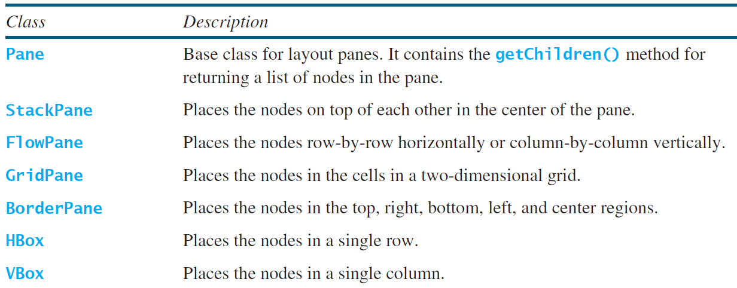
Layout Panes
Pans Layouts represent how nodes are arranged in a container.
Choosing the right Layout is 90% responsible for the responsiveness of the UI

Slide 16
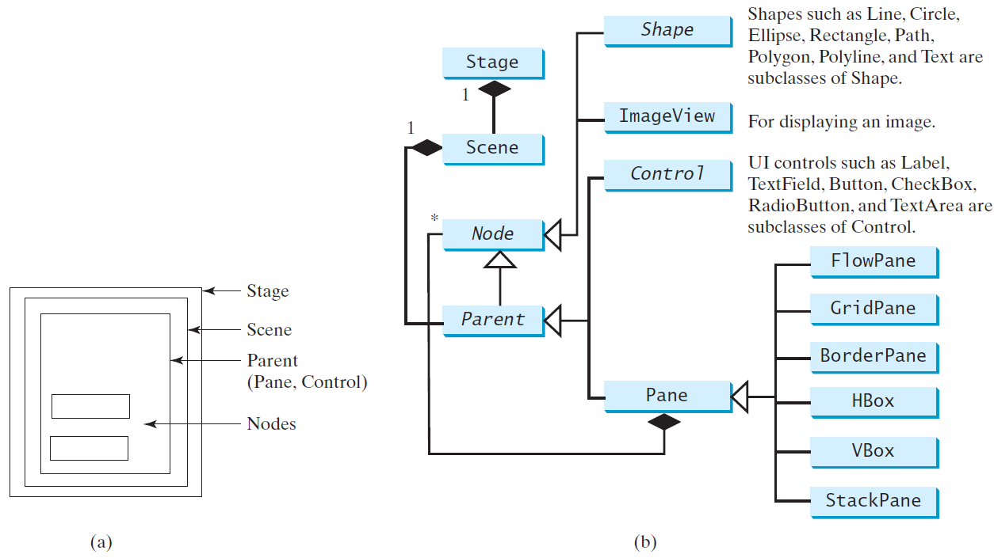
Panes, UI Controls, and Shapes
http://docs.oracle.com/javafx/2/scenegraph/jfxpub-scenegraph.htm

Slide 17
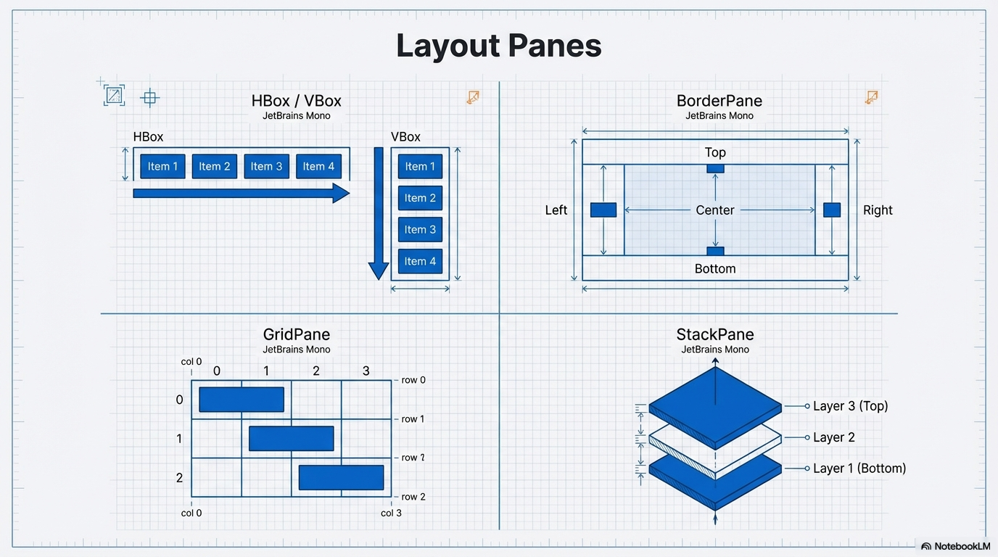

Slide 18
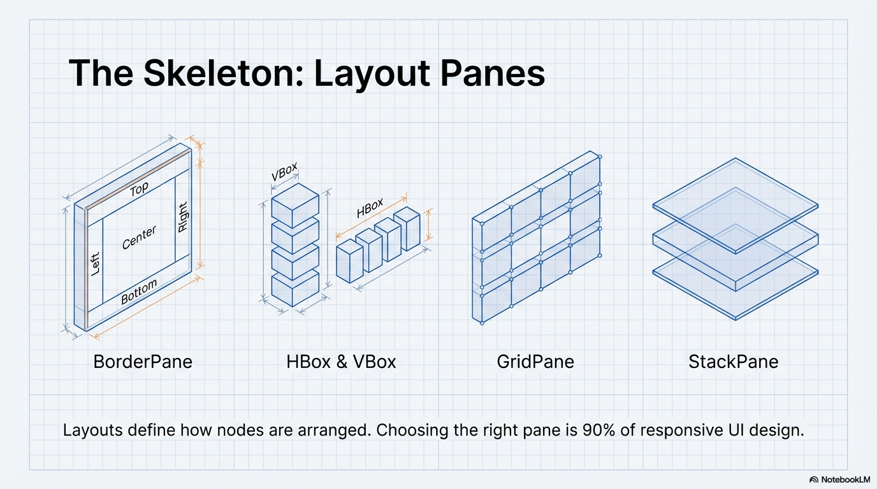

Slide 19
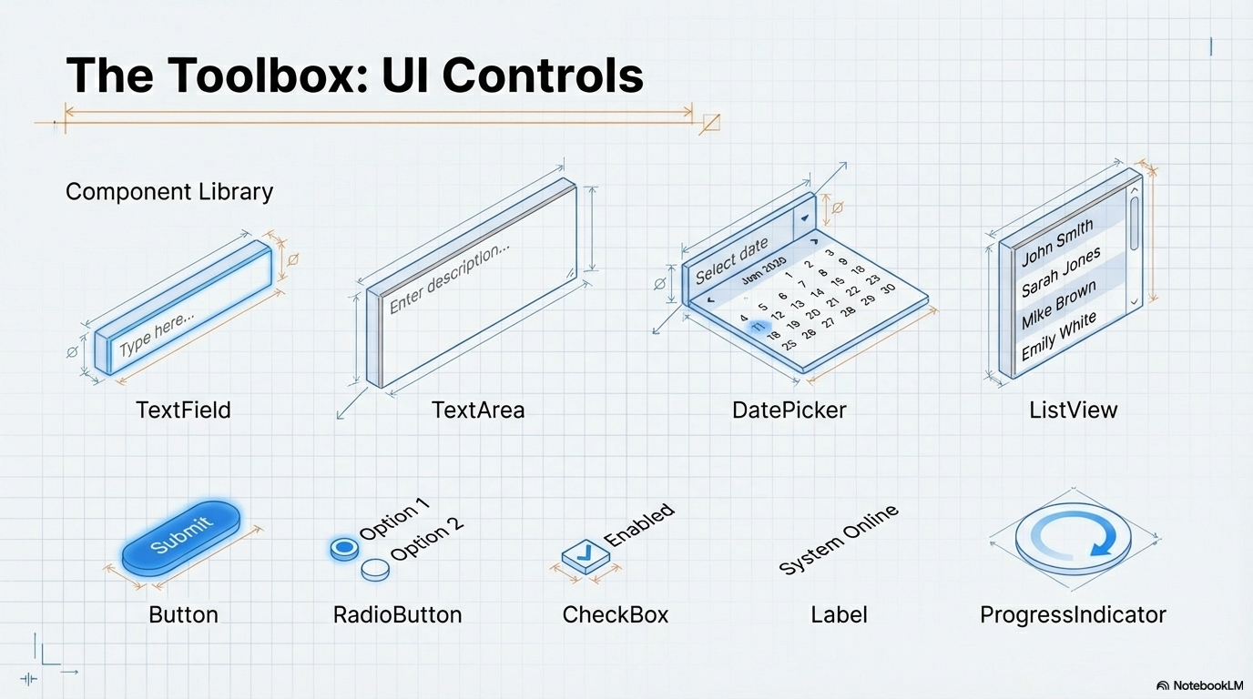
JavaFX Basic UI Controls
Label It is a component for displaying text.
Button It is a class used for creating buttons.
Menu Contains a list of commands or options.
ToolTip A pop-up window that displays some additional information about other UI elements.
TextField Accepts and displays user input.

Slide 21
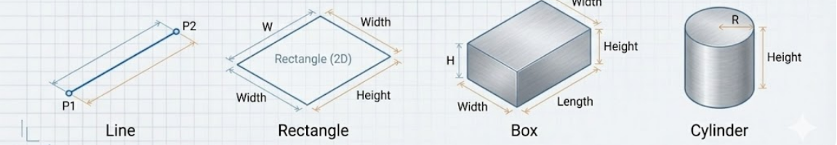
JavaFX Shapes
Line
It is a class that represents a line. In general, line is a two-dimensional geometrical shape consist of two points.
Rectangle
It is a class used for creating a 2D rectangular shape. In mathematical terms, rectangle is a four-sided polygon.
Box
This JavaFX class represents a three-dimensional shape having length, width and height.
Cylinder
It is a JavaFX class used to create a Cylinder. In general, cylinder is a closed solid figure that has two properties namely radius and height.

Slide 22
JavaFX Shapes
import javafx.application.Application;
import javafx.scene.Scene;
import javafx.scene.layout.Pane;
import javafx.scene.paint.Color;
import javafx.scene.shape.Line;
import javafx.stage.Stage;
public class LineExample extends Application {
@Override
public void start(Stage stage) {
Line line = new Line(50, 50, 250, 200);
line.setStroke(Color.BLUE);
line.setStrokeWidth(3);
Pane root = new Pane(line);
Scene scene = new Scene(root, 300, 250);
stage.setTitle("Line Example");
stage.setScene(scene);
stage.show();
}
public static void main(String[] args) {
launch();
}
}
Line

Slide 23
JavaFX Shapes
import javafx.application.Application;
import javafx.scene.Scene;
import javafx.scene.layout.Pane;
import javafx.scene.paint.Color;
import javafx.scene.shape.Rectangle;
import javafx.stage.Stage;
public class RectangleExample extends Application {
@Override
public void start(Stage stage) {
Rectangle rectangle = new Rectangle(100, 75, 200, 100);
rectangle.setFill(Color.LIGHTGREEN);
rectangle.setStroke(Color.BLACK);
Pane root = new Pane(rectangle);
Scene scene = new Scene(root, 400, 250);
stage.setTitle("Rectangle Example");
stage.setScene(scene);
stage.show();
}
public static void main(String[] args) {
launch();
}
}
Rectangle

Slide 24
JavaFX Shapes
public class BoxExample extends Application {
@Override
public void start(Stage stage) {
Box box = new Box(150, 150, 150);
PhongMaterial material = new PhongMaterial();
material.setDiffuseColor(Color.CORNFLOWERBLUE);
box.setMaterial(material);
Group root = new Group(box);
Scene scene = new Scene(root, 400, 400, true);
scene.setCamera(new PerspectiveCamera());
stage.setTitle("Box Example");
stage.setScene(scene);
stage.show();
}
public static void main(String[] args) {
launch();
}
}
Box (3D shape)
import javafx.application.Application;
import javafx.scene.*;
import javafx.scene.paint.Color;
import javafx.scene.paint.PhongMaterial;
import javafx.scene.shape.Box;
import javafx.stage.Stage;
Notes:
new Scene(root, 400, 400, true);
true = "Enable 3D rendering support (depth handling)" false (or omitting it) = Normal 2D scene.

Slide 25
JavaFX Shapes
public class CylinderExample extends Application {
@Override
public void start(Stage stage) {
Cylinder cylinder = new Cylinder(80, 200);
PhongMaterial material = new PhongMaterial();
material.setDiffuseColor(Color.ORANGE);
cylinder.setMaterial(material);
Group root = new Group(cylinder);
Scene scene = new Scene(root, 400, 400, true);
scene.setCamera(new PerspectiveCamera());
stage.setTitle("Cylinder Example");
stage.setScene(scene);
stage.show();
}
public static void main(String[] args) {
launch();
}
}
Cylinder
import javafx.application.Application;
import javafx.scene.*;
import javafx.scene.paint.Color;
import javafx.scene.paint.PhongMaterial;
import javafx.scene.shape.Cylinder;
import javafx.stage.Stage;
Notes:
PhongMaterial() is a JavaFX class used to define the surface appearance of 3D shapes.
It applies lighting effects (shading, reflection, color) based on the Phong lighting model, which makes 3D objects look realistic.

Slide 26
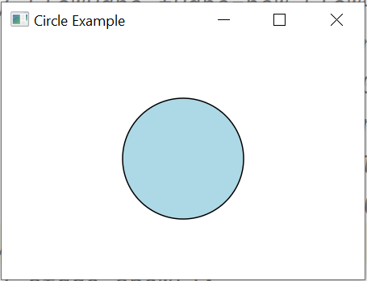
JavaFX Shapes
import javafx.application.Application;
import javafx.scene.*;
import javafx.scene.paint.Color;
import javafx.scene.shape.Circle;
import javafx.stage.Stage;
public class CircleExample extends Application {
@Override
public void start(Stage stage) {
Circle circle = new Circle(150, 100, 50);
circle.setFill(Color.LIGHTBLUE);
circle.setStroke(Color.BLACK);
Group root = new Group(circle);
Scene scene = new Scene(root, 300, 200);
stage.setTitle("Circle Example");
stage.setScene(scene);
stage.show();
}
public static void main(String[] args) {
launch();
}
}
Circle

Slide 27
JavaFX Text
import javafx.application.Application;
import javafx.scene.*;
import javafx.scene.text.*;
import javafx.stage.Stage;
public class DisplayingText extends Application {
@Override
public void start(Stage stage) {
Text text = new Text(50, 150, "Welcome to JavaFX");
text.setFont(new Font(45));
Group root = new Group(text);
stage.setScene(new Scene(root, 600, 300));
stage.setTitle(“Welcome Page");
stage.show();
}
public static void main(String[] args) {
launch();
}
}
Notes:
For 3D shapes (Box & Cylinder):
✔ Scene must use true for depth buffer ✔ You must set a PerspectiveCamera() ✔ Sometimes you may rotate the shape to see depth better
Example rotation (optional):
box.setRotate(30);

Slide 28
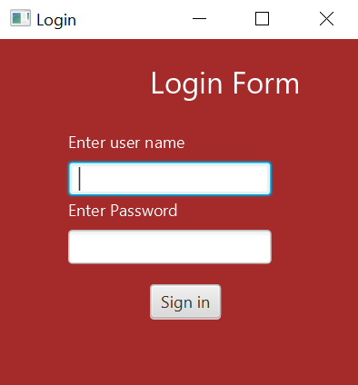
Login Form
Create A login form such as the following:

Slide 29
Login Form
public class LoginForm extends Application {
@Override
public void start(Stage stage) {
Text title = new Text(110, 40, "Login Form");
title.setFill(Color.WHITE);
title.setFont(Font.font(22));
Text user = new Text(50, 80, "Enter user name");
user.setFill(Color.WHITE);
TextField tf = new TextField();
tf.setLayoutX(50); tf.setLayoutY(90);
Text pass = new Text(50, 130, "Enter Password");
pass.setFill(Color.WHITE);
PasswordField pf = new PasswordField();
pf.setLayoutX(50); pf.setLayoutY(140);
import javafx.application.Application;
import javafx.scene.*;
import javafx.scene.control.*;
import javafx.scene.paint.Color;
import javafx.scene.text.*;
import javafx.stage.Stage;

Slide 30
Login Form
Button btn = new Button("Sign in");
btn.setLayoutX(110); btn.setLayoutY(180);
Group root = new Group(title, user, tf, pass, pf, btn);
Scene scene = new Scene(root, 300, 230, Color.BROWN);
stage.setScene(scene);
stage.setTitle("Login");
stage.show();
}
public static void main(String[] args) {
launch();
}
}

Slide 31
Assignment
Write a JavaFX program that creates a simple graphical dashboard with the following requirements:
Stage Setup
Create a Stage with a title "JavaFX Node & Group Practice".
Set the size of the window to 600x400 pixels.
Scene & Group
Create a Group as the root node.
Add a Scene to the stage using this root group.
Add Nodes to the Group Inside the root Group, add the following nodes:
Circle
Color: Blue
Radius: 50
Position: (100, 100)
Rectangle
Color: Green
Width: 150, Height: 80
Position: (250, 50)
Text
Display your name or a message like "Welcome to JavaFX!"
Position: (200, 200)
Font size: 20
Button
Label: "Click Me"
Position: (250, 300)

Slide 32

Thank you

